Slide 1

Policy Iteration
Notes:
1

Slide 2
Objectives
Understand the policy improvement theorem
Use a value function for a policy to produce a better policy for a given MDP
Apply policy iteration to compute optimal policies and optimal value functions
2
Notes:
2

Slide 3
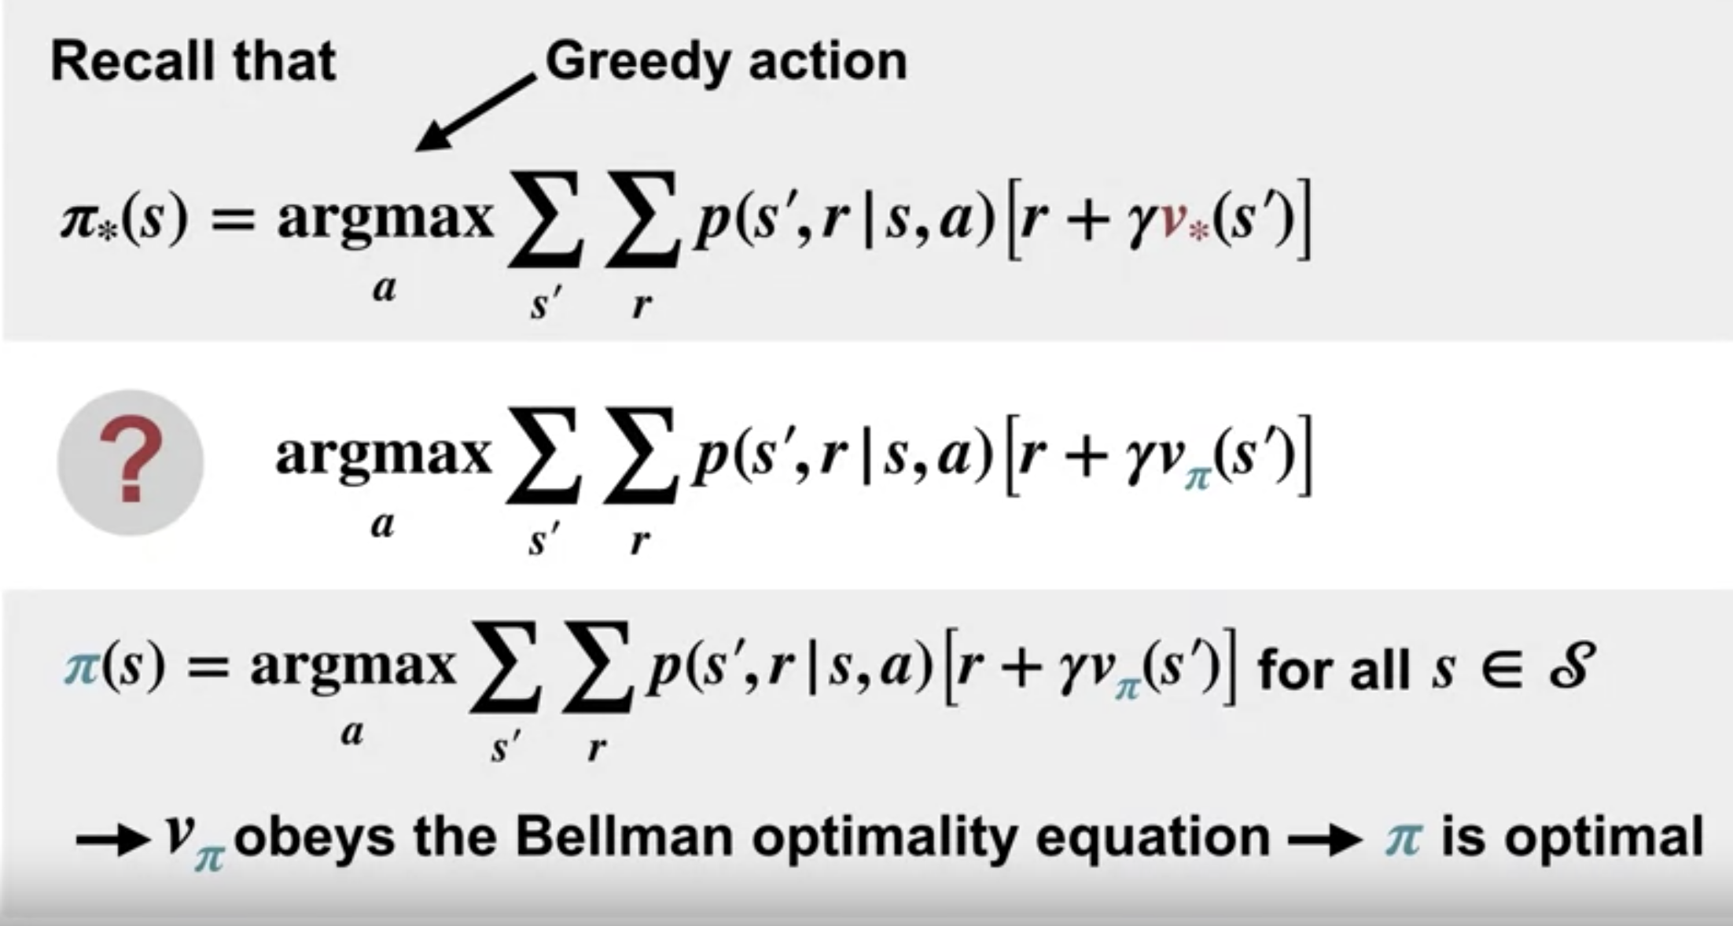
Policy Improvement
We can find the optimal policy by choosing the Greedy action.
The Greedy action maximizes the Bellman's optimality equation in each state.
3
Policy Iteration
Notes:
3

Slide 4
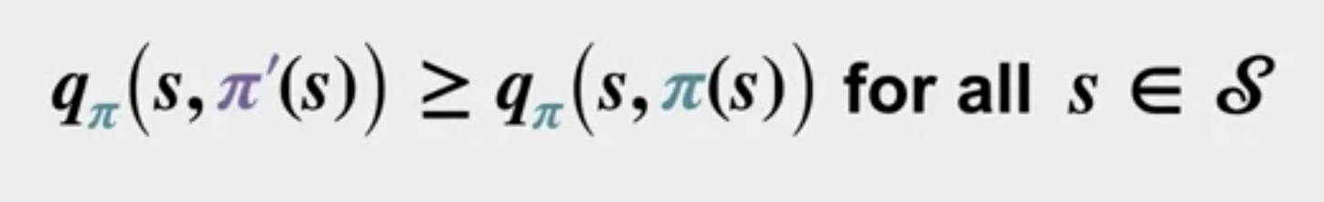
Policy Improvement
The new policy obtained in this way must be a strict improvement on Pi, unless Pi was already optimal.
Policy improvement theorem: q Pi: value of a state if you take action A, and then follow policy Pi.
4
Policy Iteration
Notes:
4

Slide 5
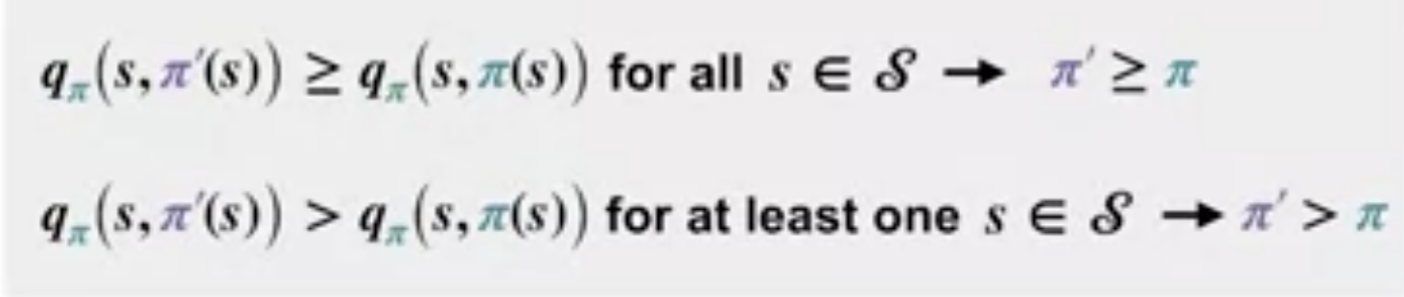
Policy Improvement
Policy Pi prime is at least as good as Pi if in each state, the value of the action selected by Pi prime is greater than or equal to the value of the action selected by Pi.
Policy pi prime is strictly better if the value is strictly greater and at least one state.
5
Policy Iteration
Notes:
5

Slide 6
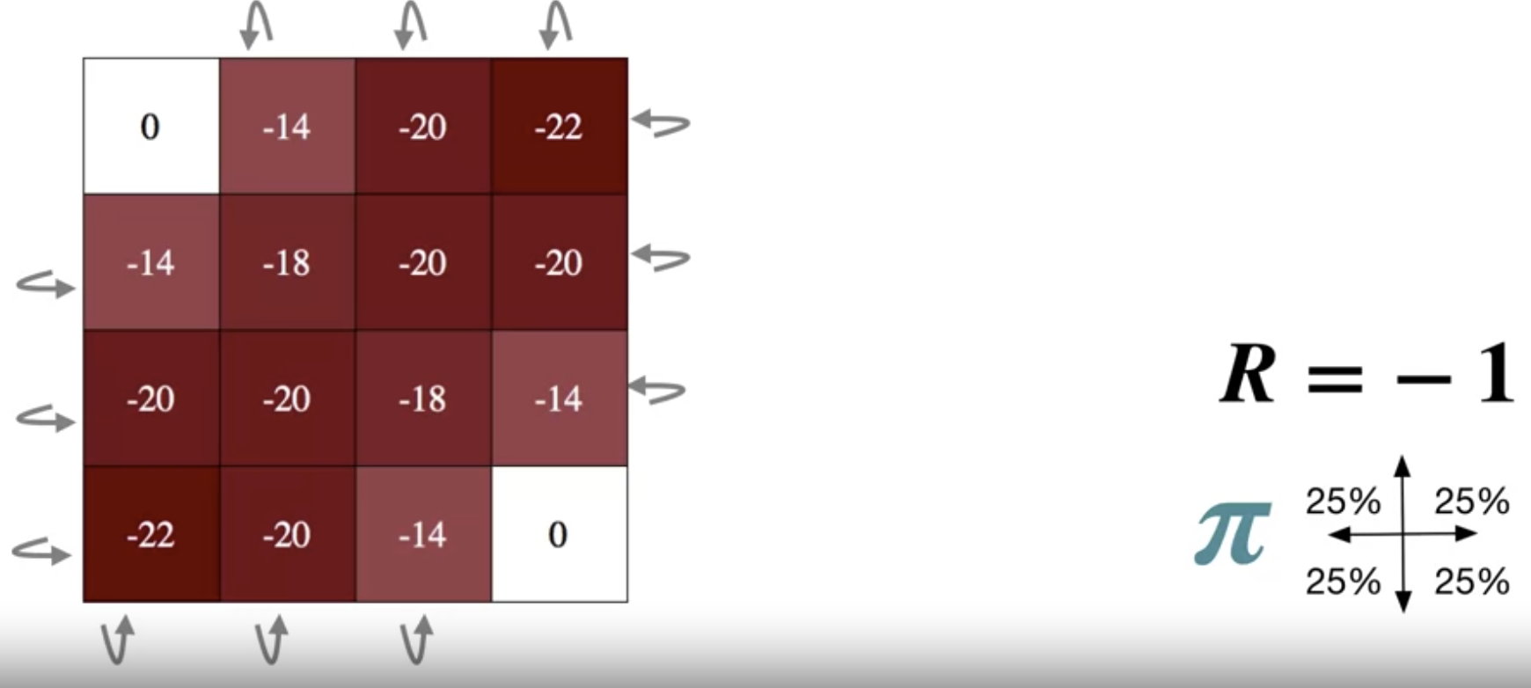
Policy Improvement
For example the four-by-four grid. The final value function:
6
Policy Iteration
Notes:
6

Slide 7
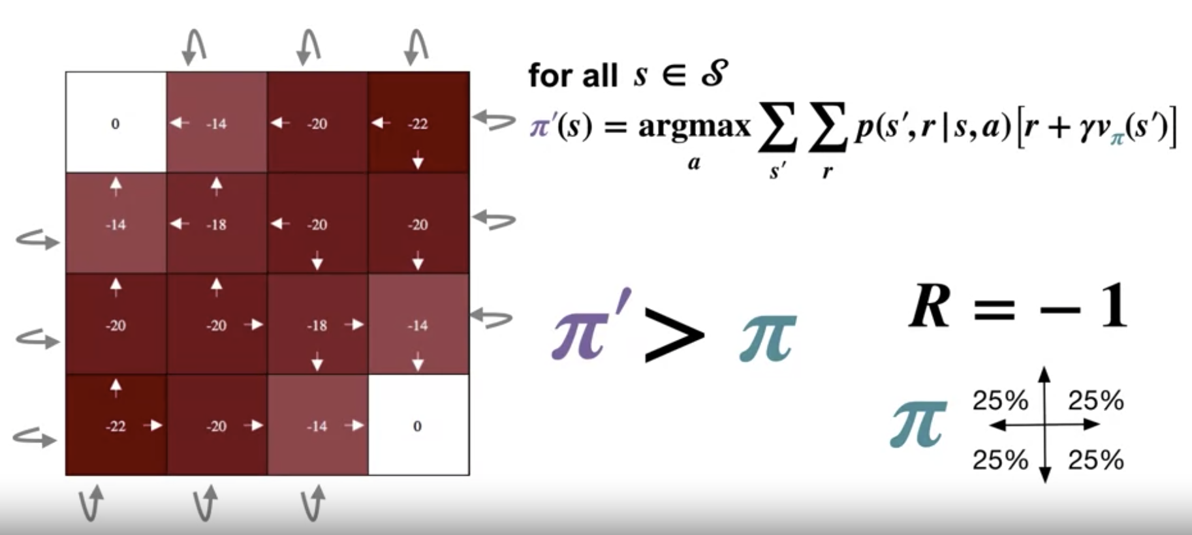
Policy Improvement
The greedy Pi policy
7
Policy Iteration
Notes:
7

Slide 8
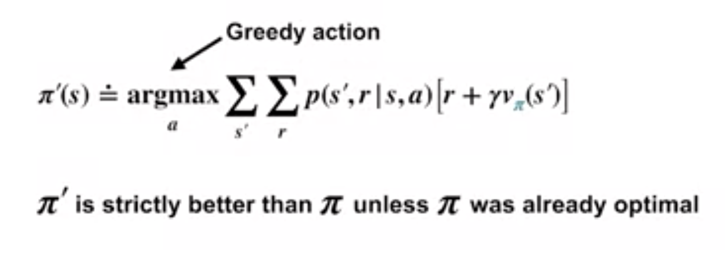
Policy Iteration
Policy improvement theorem
8
Policy Iteration
Notes:
8

Slide 9
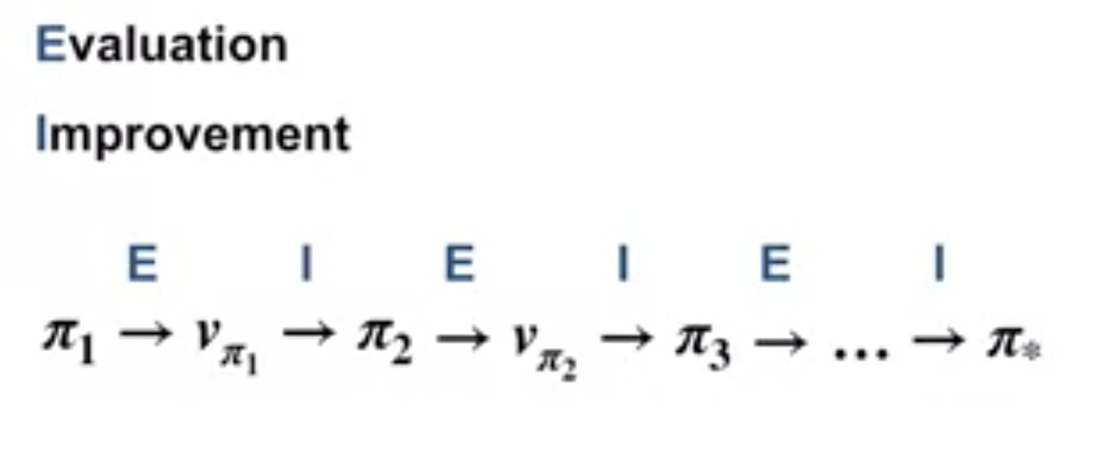
Policy Iteration
Begin with the policy Pi 1→ evaluate Pi 1 using iterative policy evaluation to obtain the state value, V Pi 1. --> evaluation step.
Using the results of the policy improvement theorem, we can then greedify with respect to v Pi 1 to obtain a better policy, Pi 2--> We call this the improvement step.
We can then compute V Pi 2 and use it to obtain an even better policy, Pi 3. This gives us a sequence of better policies.
9
Policy Iteration
Notes:
9

Slide 10
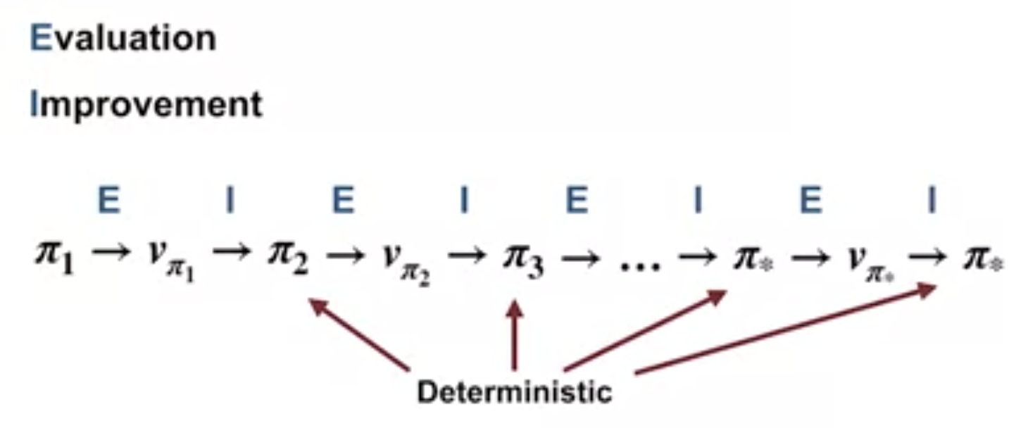
Policy Iteration
We complete an iteration, and the policy remains unchanged→ found the optimal policy.
Each policy generated in this way is deterministic.
This method of finding an optimal policy is called policy iteration.
10
Policy Iteration
Notes:
10

Slide 11
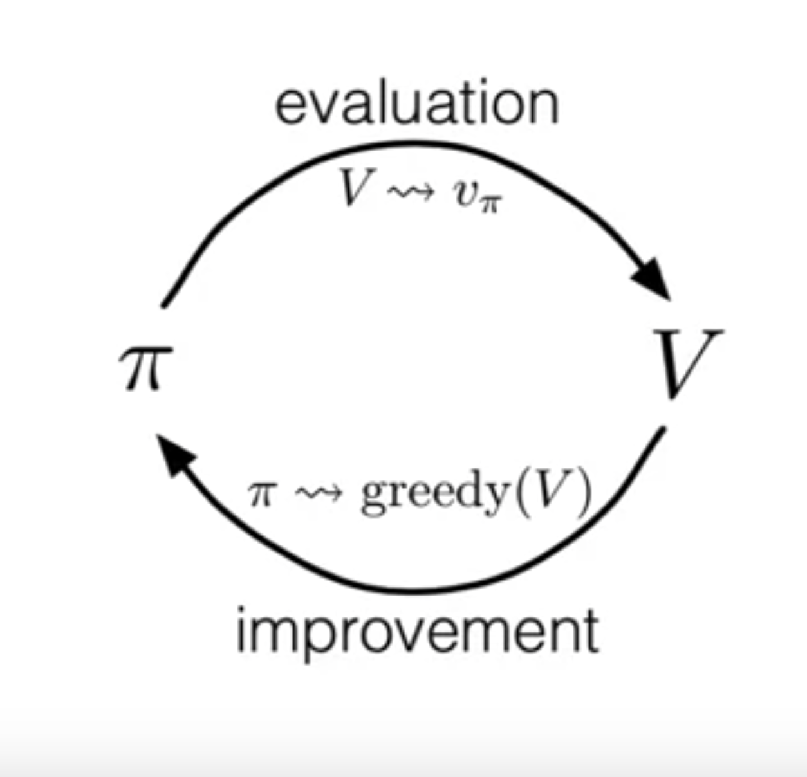
Policy Iteration
Policy iteration consists of two distinct steps: evaluation and improvement.
11
Policy Iteration
Notes:
11

Slide 12
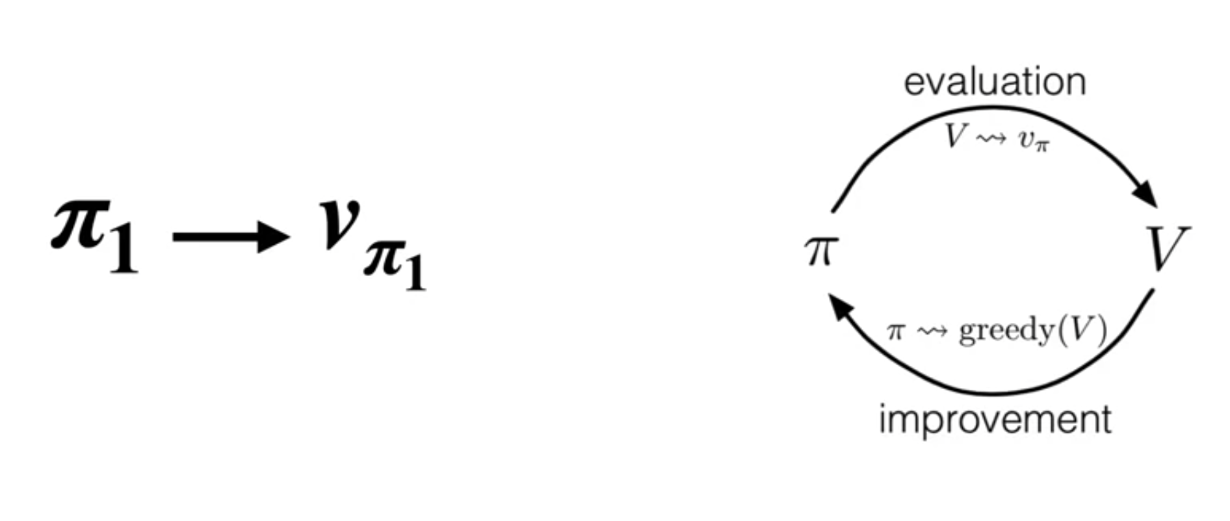
Policy Iteration
We first evaluate our current policy, Pi 1, which gives us a new value function that accurately reflects the value of Pi 1.
12
Policy Iteration
Notes:
12

Slide 13
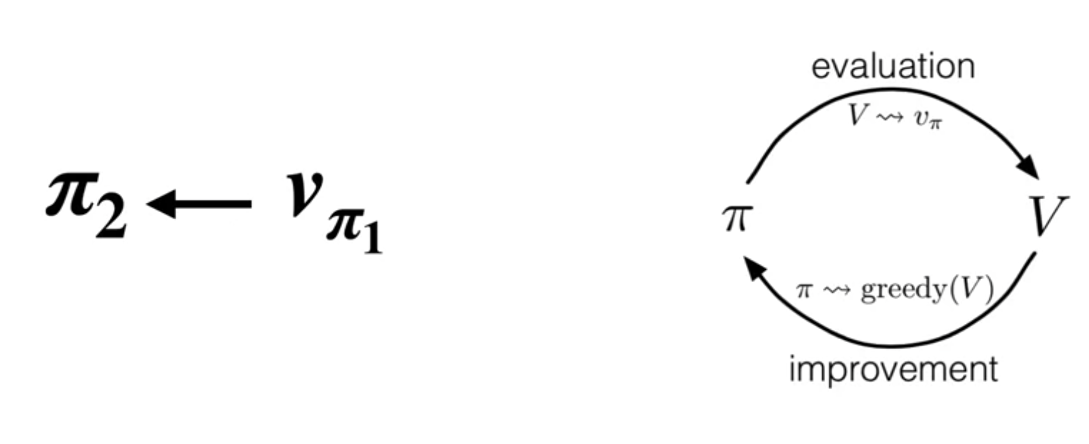
Policy Iteration
The improvement step then uses V Pi 1 to produce a greedy policy Pi 2. At this point, Pi 2 is greedy with respect to the value function of Pi 1, but V Pi 1 no longer accurately reflects the value of Pi 2.
13
Policy Iteration
Notes:
13

Slide 14
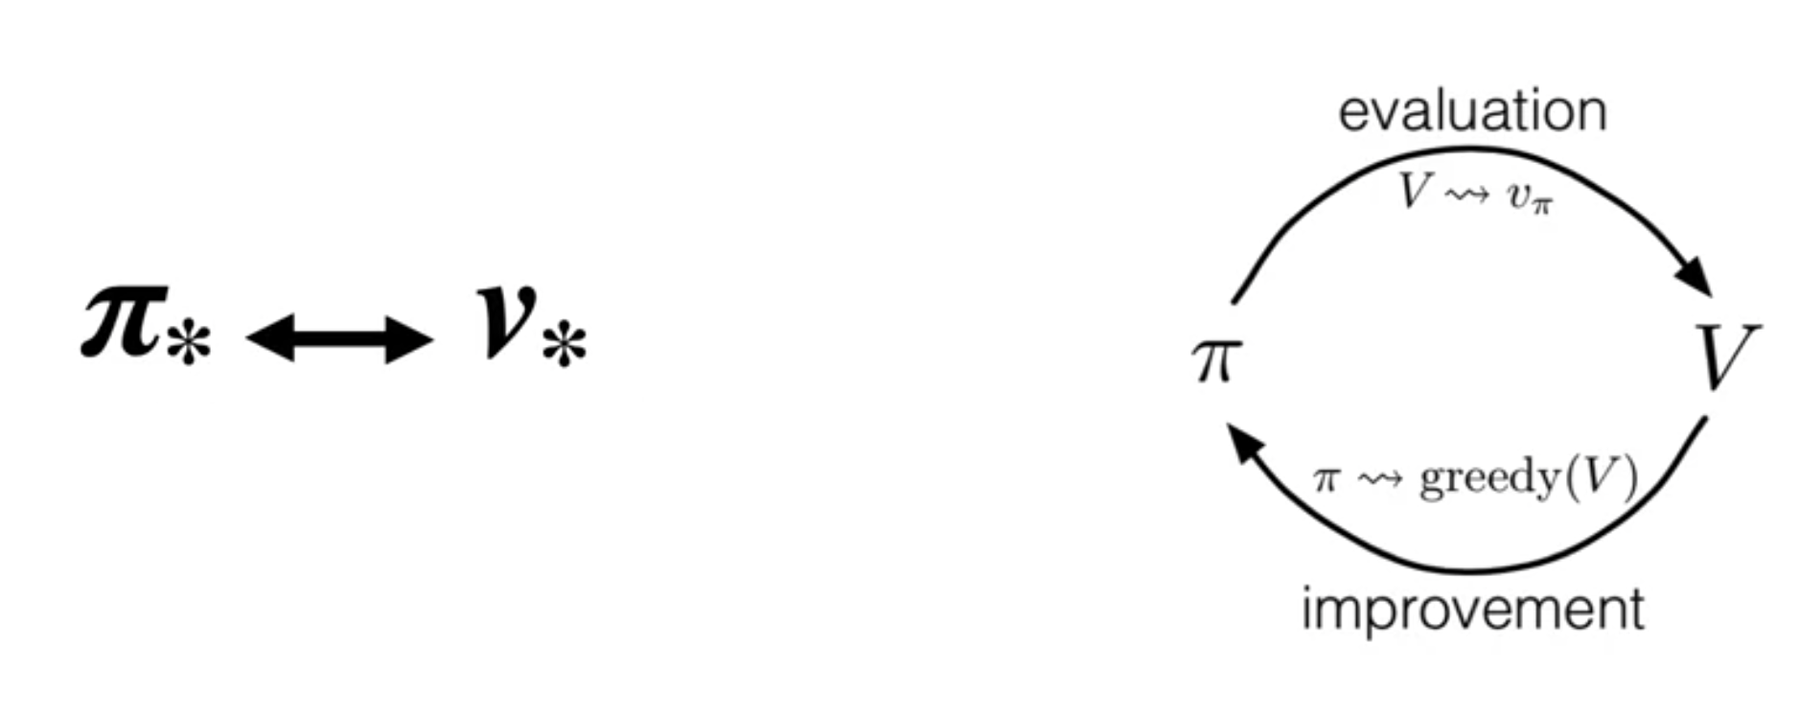
Policy Iteration
The policy is greedy and the value function is accurate.
14
Policy Iteration
Notes:
14

Slide 15
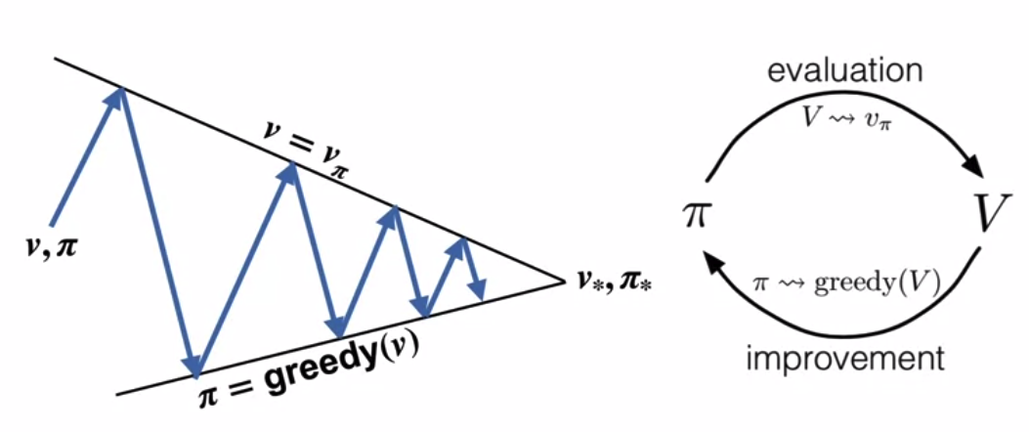
Policy Iteration
Visualization of policy iteration
15
Policy Iteration
Notes:
15

Slide 16
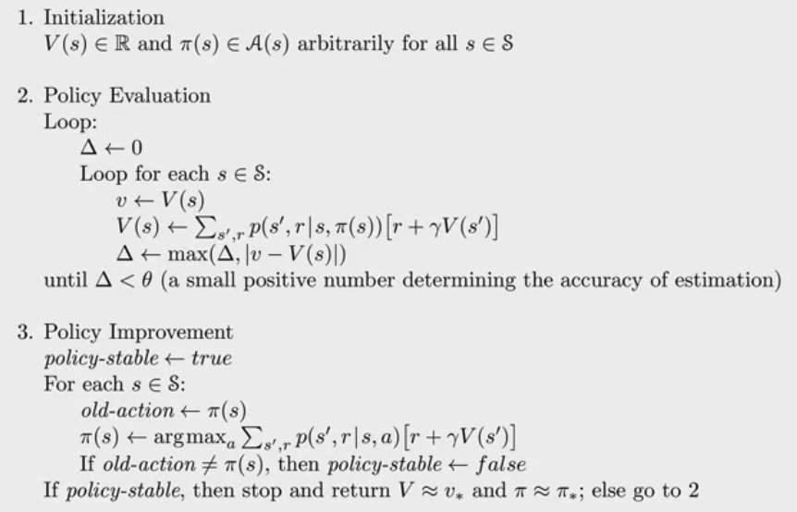
Policy Iteration
Policy Iteration using iterative policy evaluation for estimate pi ~ pi*
16
Policy Iteration
Notes:
16

Slide 17
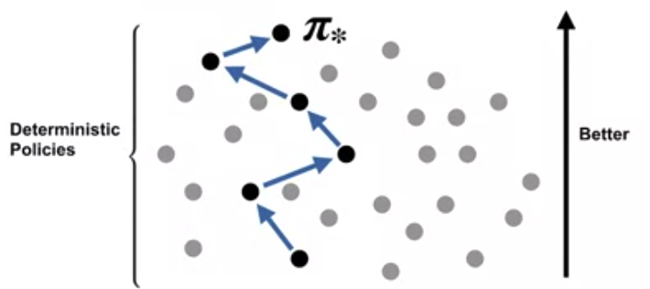
Policy Iteration
The power of policy iteration
17
Policy Iteration
Notes:
17

Slide 18
Summary
Understand the policy improvement theorem
Use a value function for a policy to produce a better policy for a given MDP
Apply policy iteration to compute optimal policies and optimal value functions
18
Policy Iteration

Slide 19
Q & A
19
Policy Iteration

